Slide 1
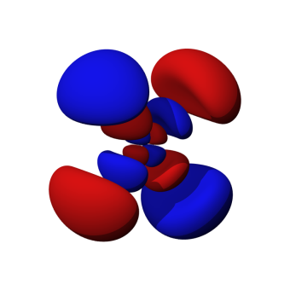
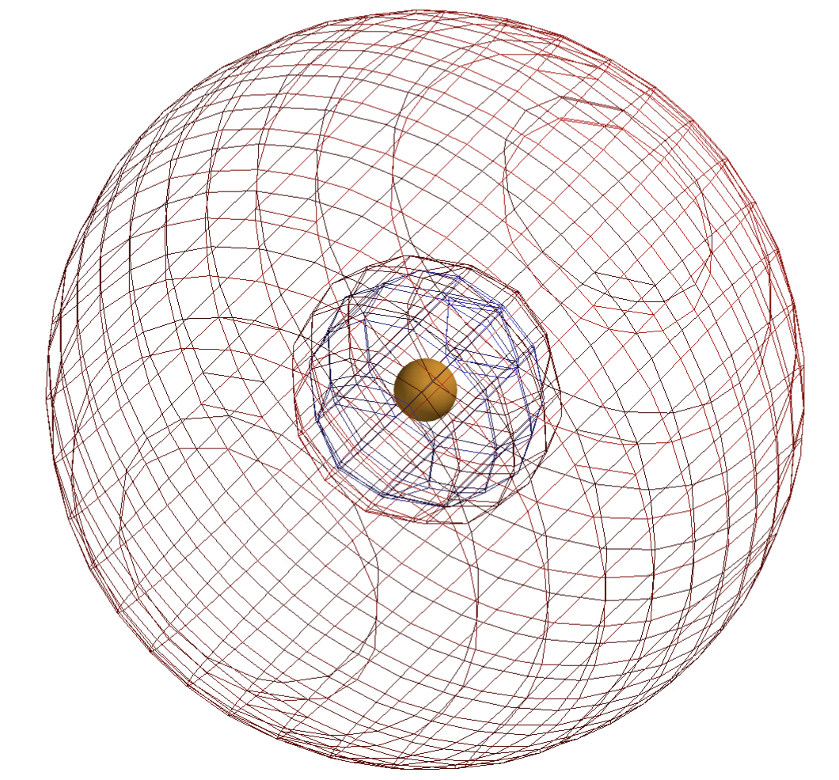
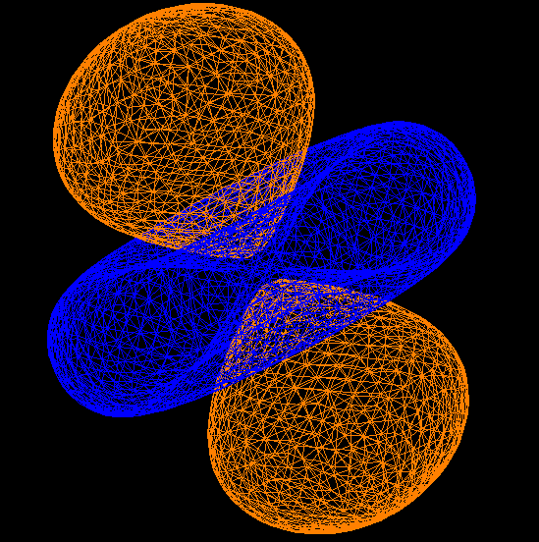
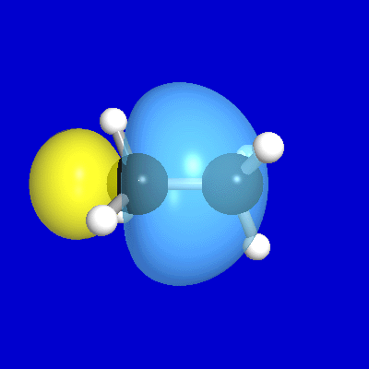
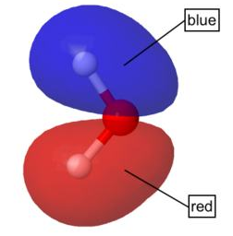
Electrons go through nodes
This one?

Slide 2
Electrons go through nodes
This one?

Slide 3
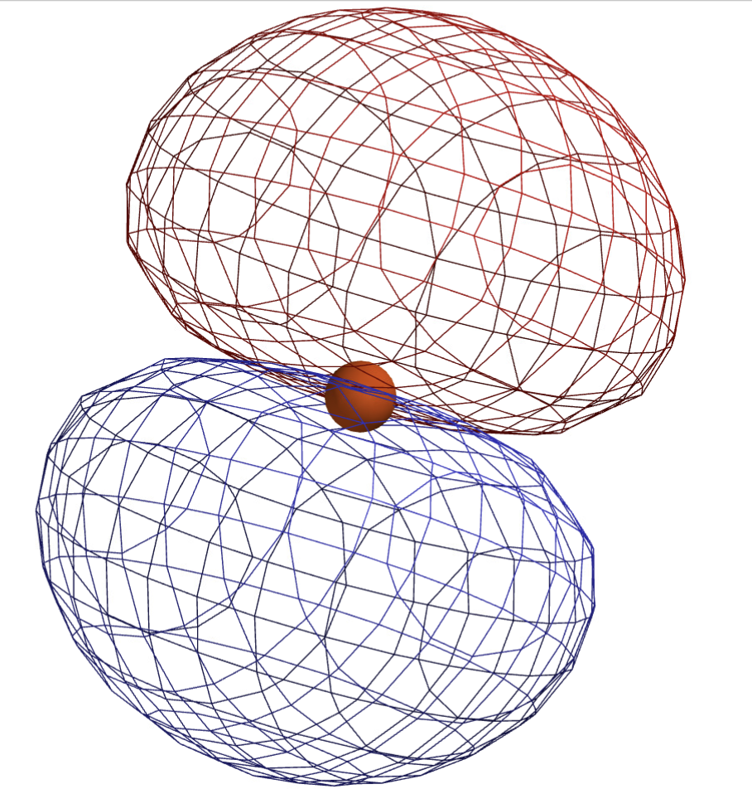
Motions associated with these orbitals?
s-orbital in the 2nd shell
Notice the radial node
One of three p-orbitals in the 2nd shell
Notice the planar node

Slide 4
Motions associated with these orbitals?
s-orbital in the 2nd shell
Notice the radial node
In-and-out breathing motion
One of three p-orbitals in the 2nd shell
These electrons have angular momentum!

Slide 5
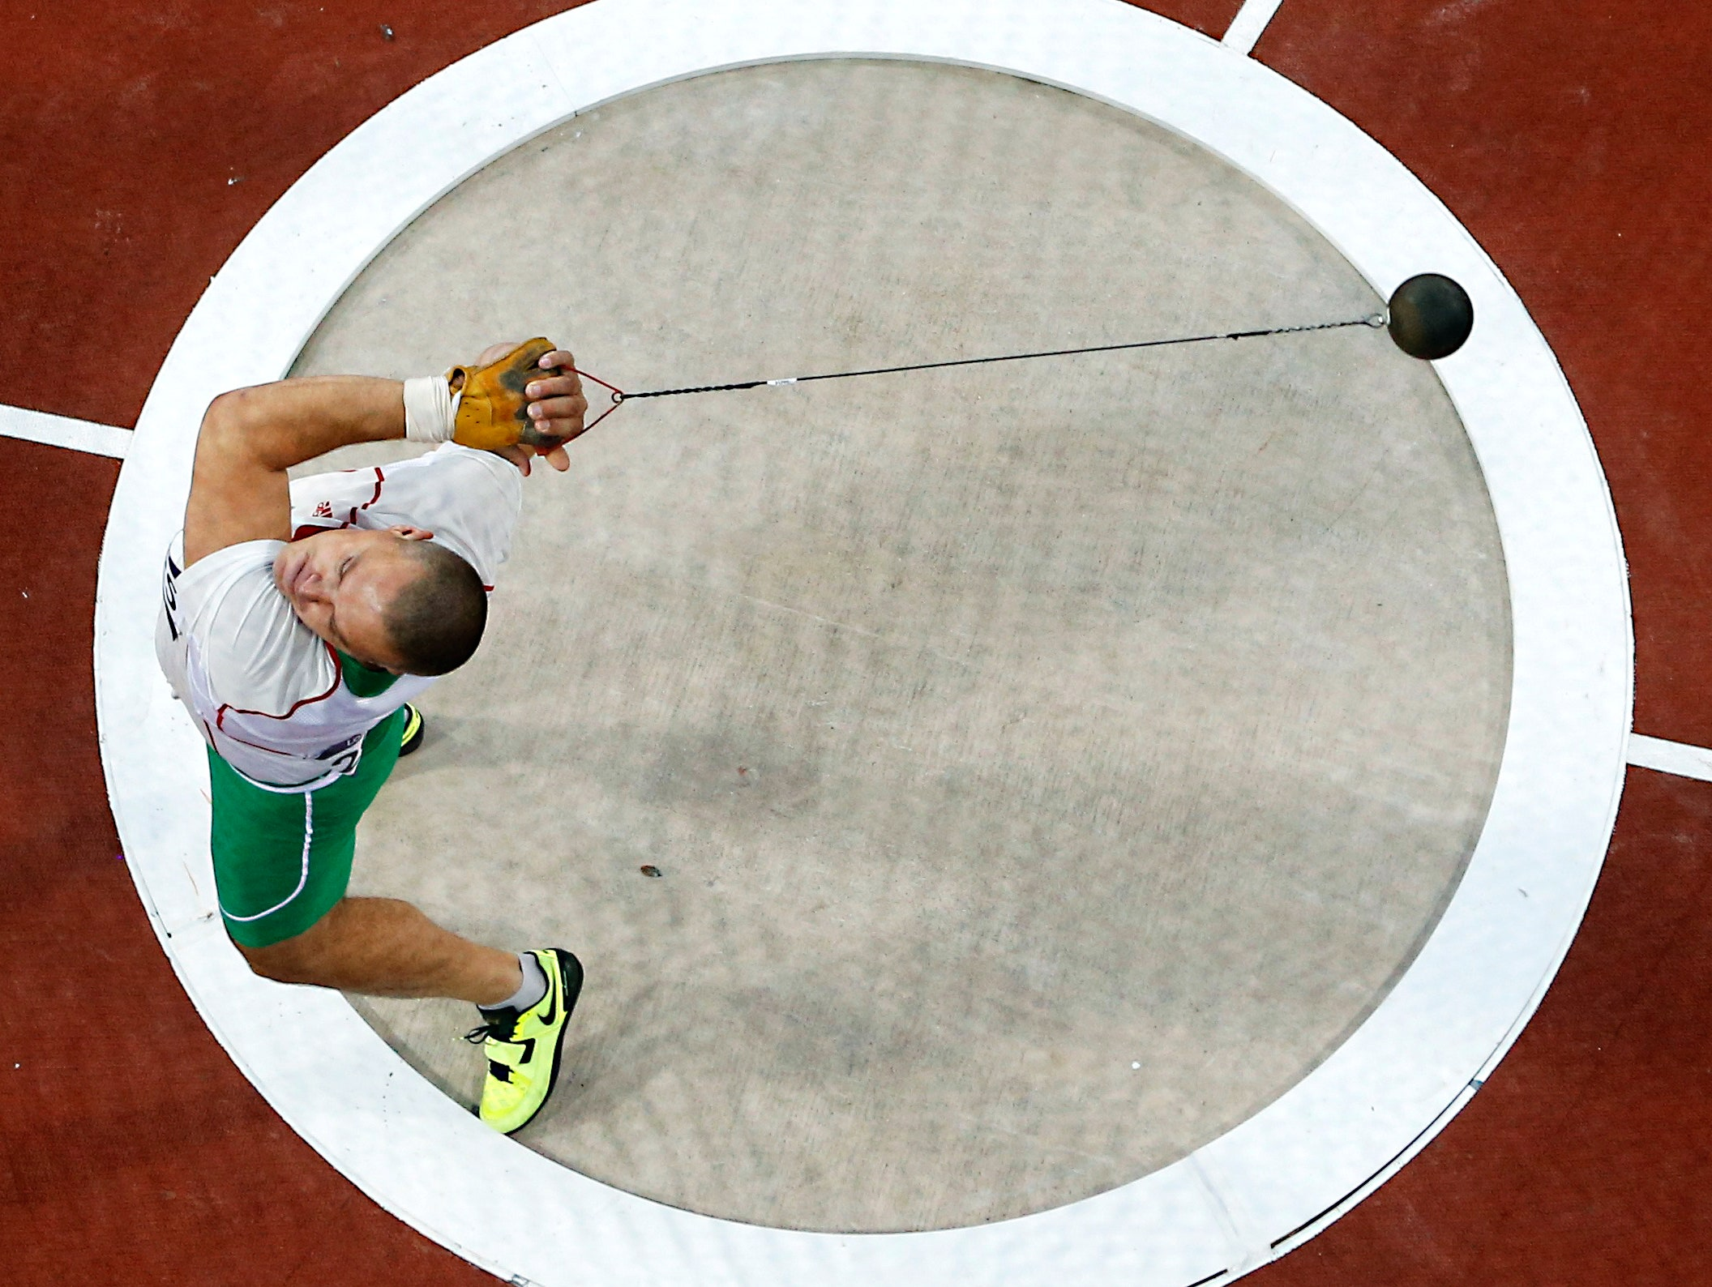
Angular momentum of an electron (or any mass circling a center point
One of three p-orbitals in the 2nd shell
These electrons have angular momentum!

Slide 6
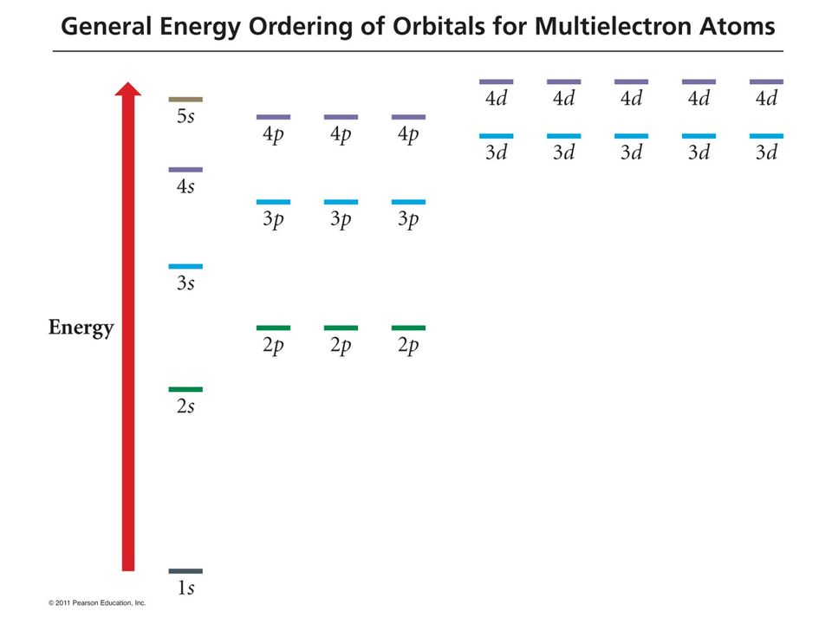
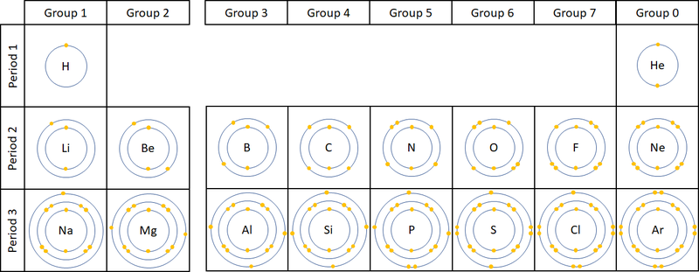
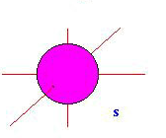
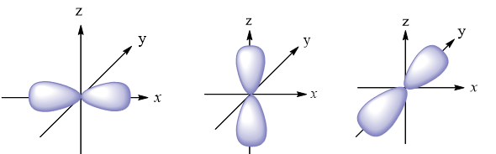
PEP, aufbau, GEOO diagrams, and electron configurations
Boron has
1s² 2s² 2p¹
(same as [He] 2s² 2p¹)
What’s next, aufbau?
2s orbital
2p orbitals

Slide 7
PEP, aufbau, GEOO diagrams, and electron configurations
Carbon has
1s² 2s² 2p²
But there’s an unexpected pattern here …
2s orbital
2p orbitals

Slide 8
PEP, aufbau, GEOO diagrams, and electron configurations
Carbon has
1s² 2s² 2p²
But there’s an unexpected pattern here …
2s orbital
2p orbitals

Slide 9
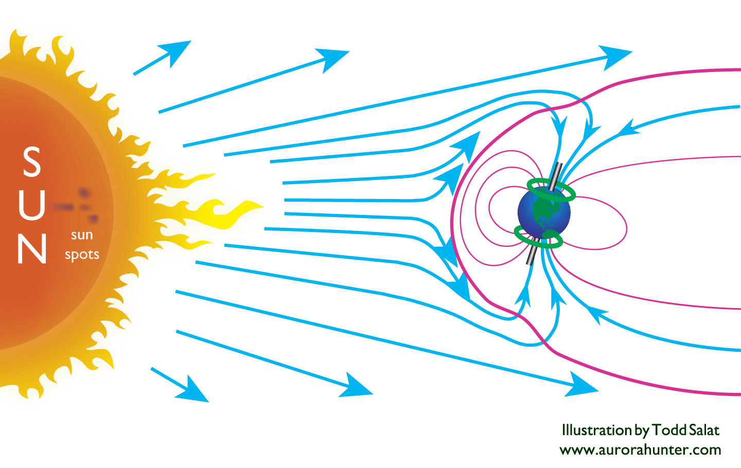
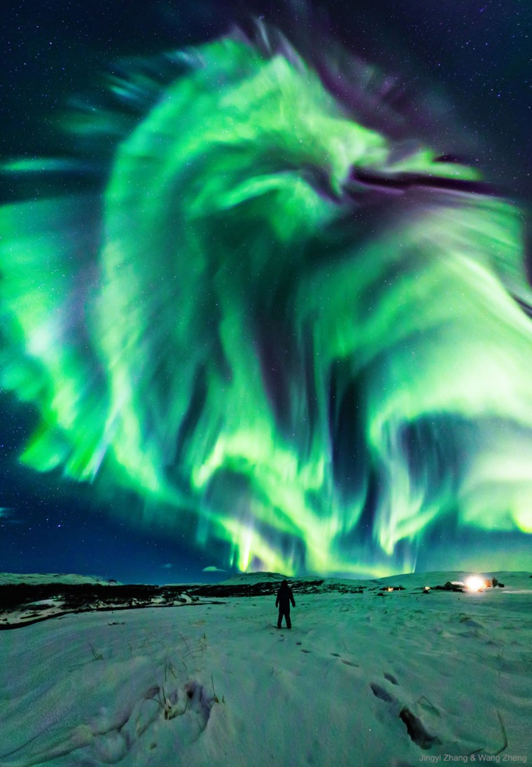
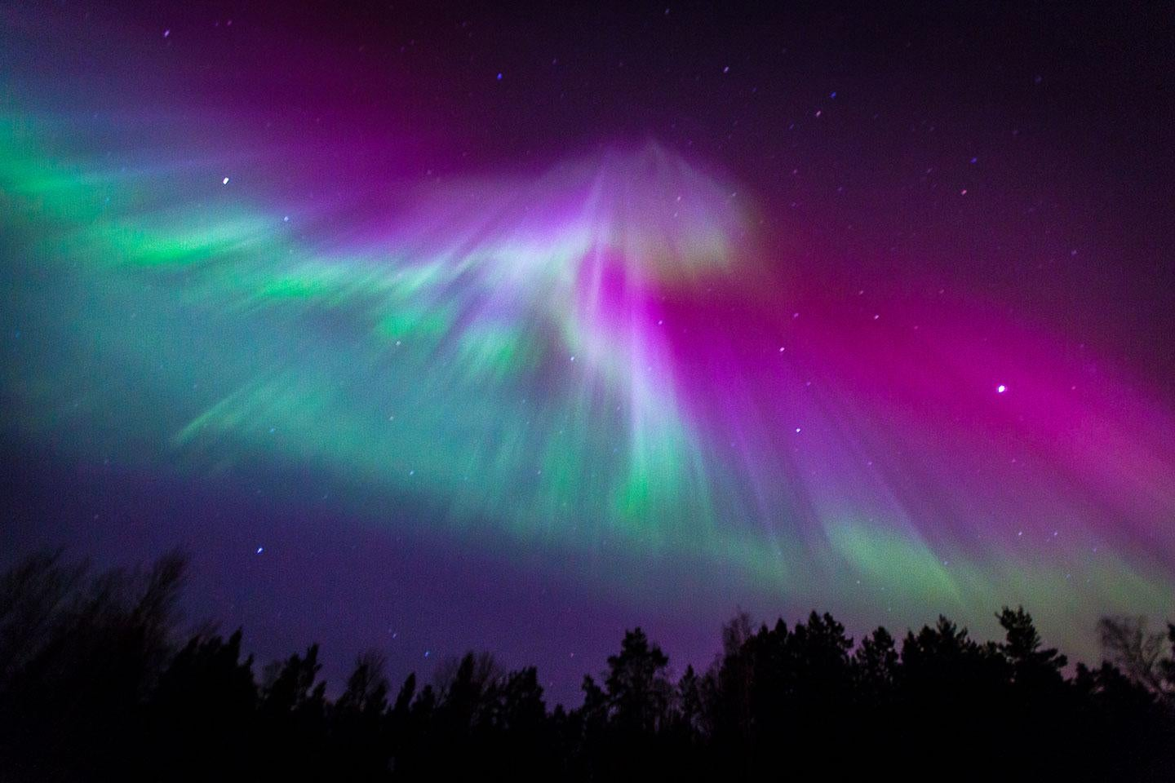
How atoms emit light (glow)
The Aurora
High-energy solar particles excite electrons on oxygen and nitrogen atoms. Subsequent relaxation causes photons to be emitted (green, red).

Slide 10
How atoms emit light (glow)
Here we have our aufbau-prescribed state, also called the ground state of Na⁺.
The gray arrow shows how a source of energy (like a flame, or electrical current, or a cosmic ray) moves an electron to a higher-energy orbital.
HOMO

Slide 11
How atoms emit light (glow)
Now Na⁺ is in an excited state.
However, the electron doesn’t stay there long: it falls to a lower orbital and emits a photon in the process.

Slide 12
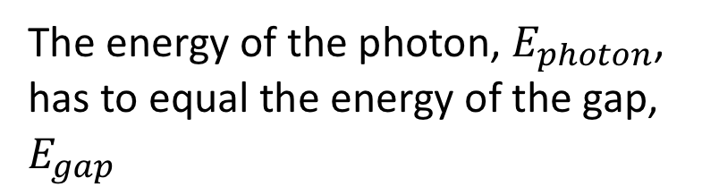
How atoms emit light (glow)
The energy of the photon, $E_{photon}$, has to equal the energy of the gap, $E_{gap}$

Slide 13
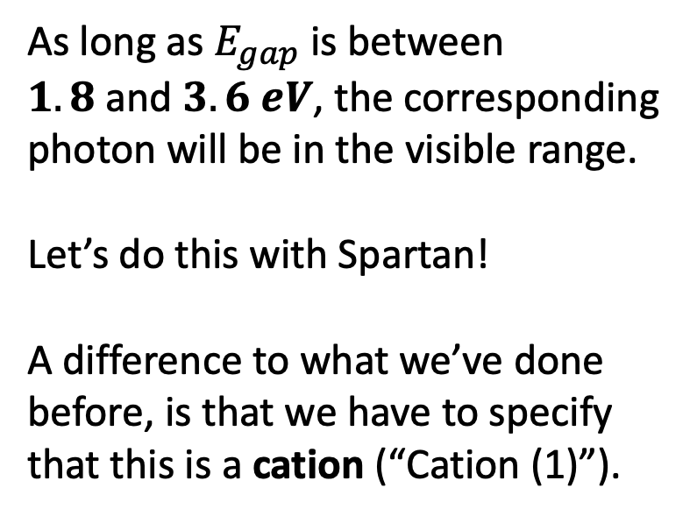
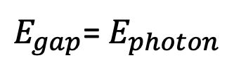
How atoms emit light (glow)
As long as $E_{gap}$is between $1.8 \text{and} 3.6 eV$, the corresponding photon will be in the visible range.
Let’s do this with Spartan!
A difference to what we’ve done before, is that we have to specify that this is a cation (“Cation (1)”).
$E_{gap}$= $E_{photon}$

Slide 14
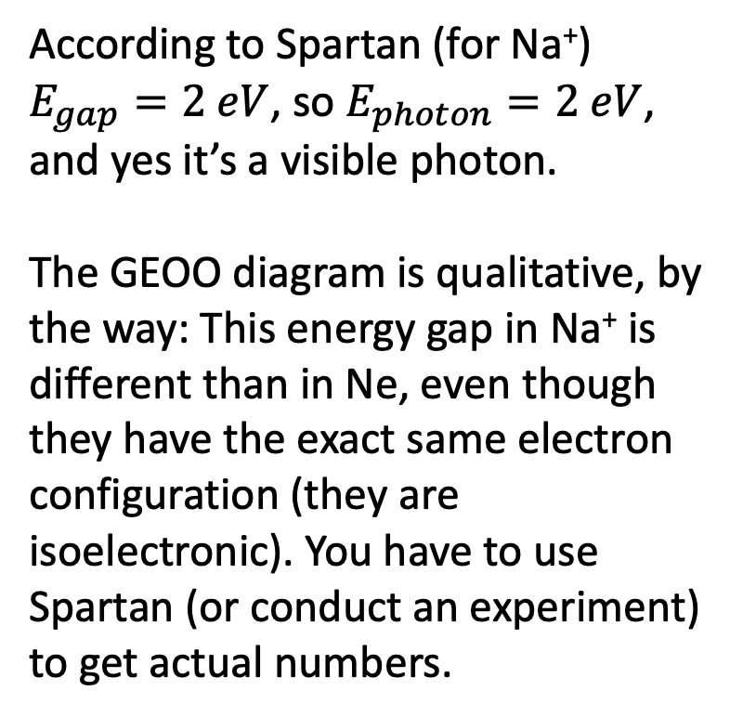
How atoms emit light (glow)
According to Spartan (for Na⁺) $E_{gap}=2 eV$, so $E_{photon}=2 eV$, and yes it’s a visible photon.
The GEOO diagram is qualitative, by the way: This energy gap in Na⁺ is different than in Ne, even though they have the exact same electron configuration (they are isoelectronic). You have to use Spartan (or conduct an experiment) to get actual numbers.
$E_{gap}$= $E_{photon}$

Slide 15


Sunlight has a full spectrum of visible light (all colors)
Red light:
Photon energy = $1.8 eV$
Blue light:
Photon energy = $3.6 eV$

Slide 16
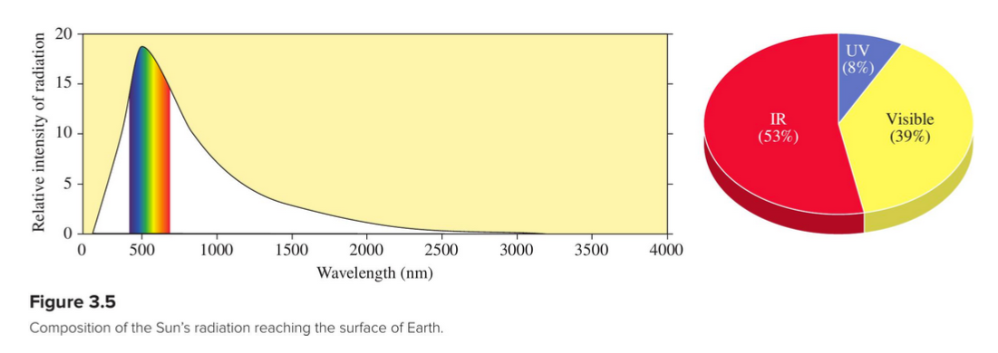
The color of light is related to the energy of its photons
Sunlight is almost 40% visible light

Slide 17
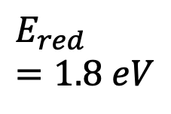
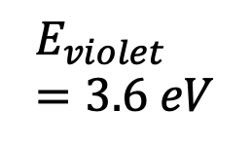
The color of light is related to the energy of its photons
$$E_{violet}=3.6 eV$$
$$E_{red}=1.8 eV$$

Slide 18
The color of light is related to the energy of its photons
uv
IR
$$E_{violet}=3.6 eV$$
$$E_{red}=1.8 eV$$
uv stands for ultraviolet, photon energy >3.6 eV (bees can see in this range)
IR stands for infrared, photon energy <1.8 eV (snakes can see in this range)

Slide 19
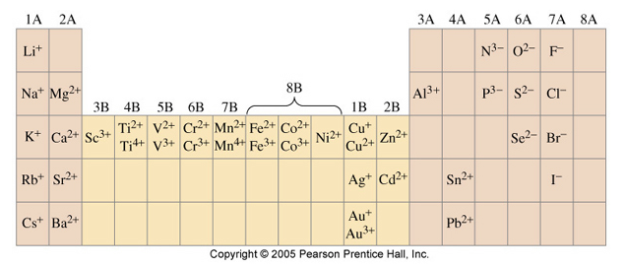
Lab on solubility
Polyatomic ions:
Ammonium, NH₄⁺
Bicarbonate, HCO₃⁻
Carbonate, CO₃²⁻
Phosphate, PO₄³⁻
Sulfate, SO₄²⁻
Family of cations is unlikely to make a precipitate …
Family of cations is somewhat likely to make a precipitate …
Writing balanced net ionic equations using the IUPAC convention
“Lead cations combine with chloride anions to produce a lead chloride precipitate”
… -> …

Slide 20
Lab on solubility
Polyatomic ions:
Ammonium, NH₄⁺
Bicarbonate, HCO₃⁻
Carbonate, CO₃²⁻
Phosphate, PO₄³⁻
Sulfate, SO₄²⁻
Family of cations is unlikely to make a precipitate … Alkali Metals
Family of cations is somewhat likely to make a precipitate … Alkali Earth Metals
Writing balanced net ionic equations using the IUPAC convention
“Lead cations combine with chloride anions to produce a lead chloride precipitate”
Pb²⁺(aq) + 2Cl⁻(aq) -> PbCl₂(s)

